Slide 1
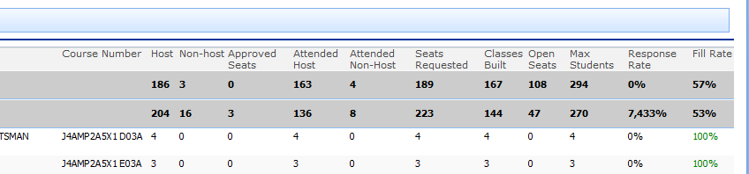
PRO Super: Overall Report
Response Rate
Rename: FTD Response Rate
Seats Requested
Divided by
Classes Built Column (see change)
Non-host
Rename
Requested
Non-Host
Host
Rename
Requested
Host
Classes Built
Rename
Total Students Attended
Fill Rate
Max Students
Divided by
Classes Built Column (see change)
Approved Seats
Rename
FTSS Approved Seats

Slide 2
PRO Super: Overall Report

